Slide 1

Using Machine Learning TO PREDICT THE LENGTH OF STAY FOR PATIENTS
Participants:
Aboli Kulkarni
Bindiya Balagopalan
Komal Jaware
Renuka Dodkey
Varun Chandran
Mentored by: Vidhya K
Notes:
Participants names

Slide 2

Project brief
Overview of study
Problem Statement:
Pressure on healthcare industry to improve performance and reduce cost
Importance of Length of Stay
a valid indicator to estimate the consumption of hospital resources
important for patient outcome
help manage patient traffic
Objective
Predicting the Length of stay (LoS) for patient at the time of admission.
Notes:
Remove Background part

Slide 3
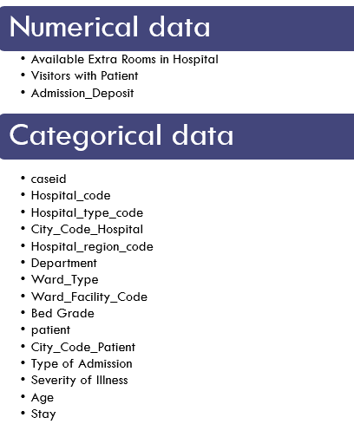
Introduction to data
Patient information collected at the time of admission
The data contains 318438 rows and 18 columns
Data dominated by categorical variables
Missing Values: Bed Grade-113 (0.03%), City_Code_Patient-4532 (1.42%)
Notes:
Description to next slide

Slide 4
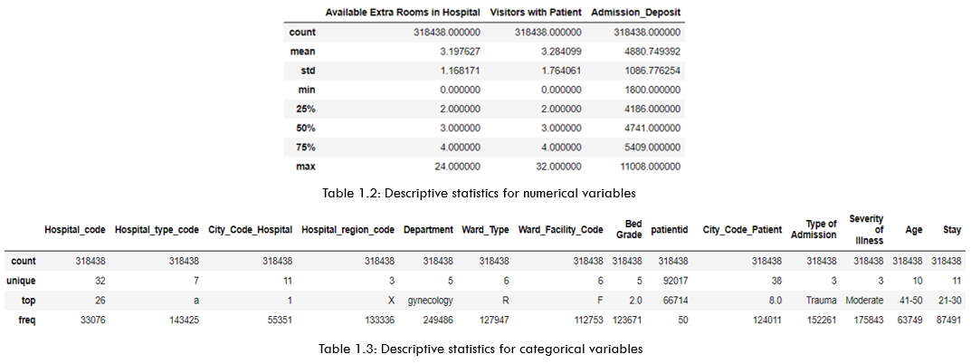
DESCRIPTIVE Statistics
Near normal distribution for numeric
Most patients for region X, Gynecology department, moderate severity

Slide 5
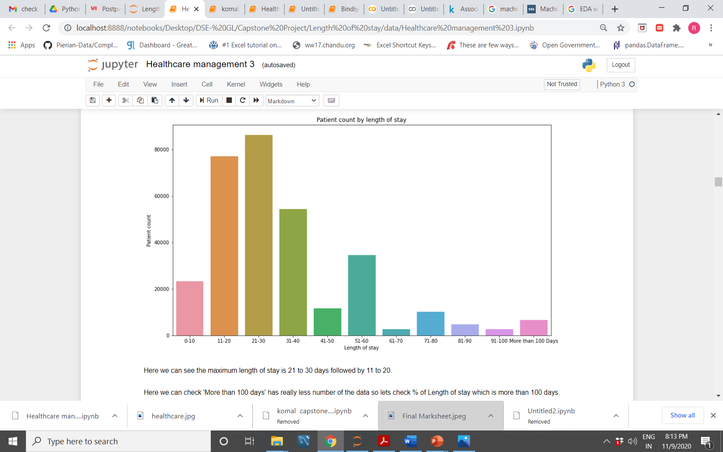
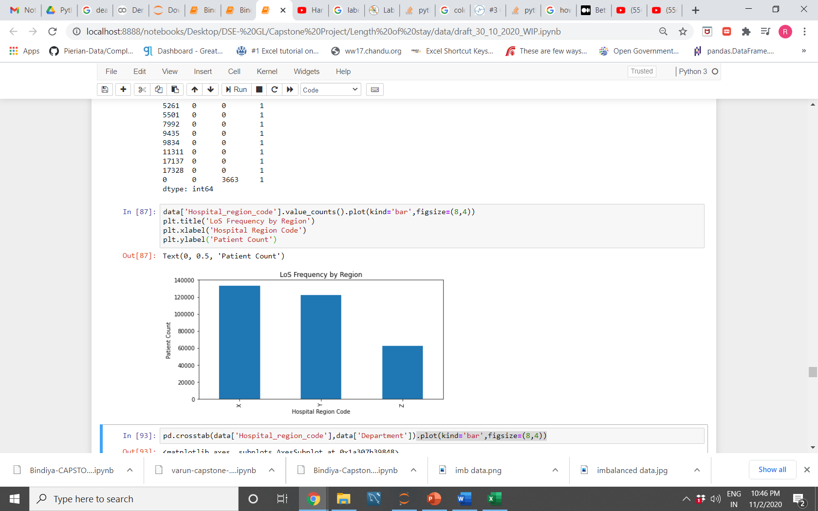
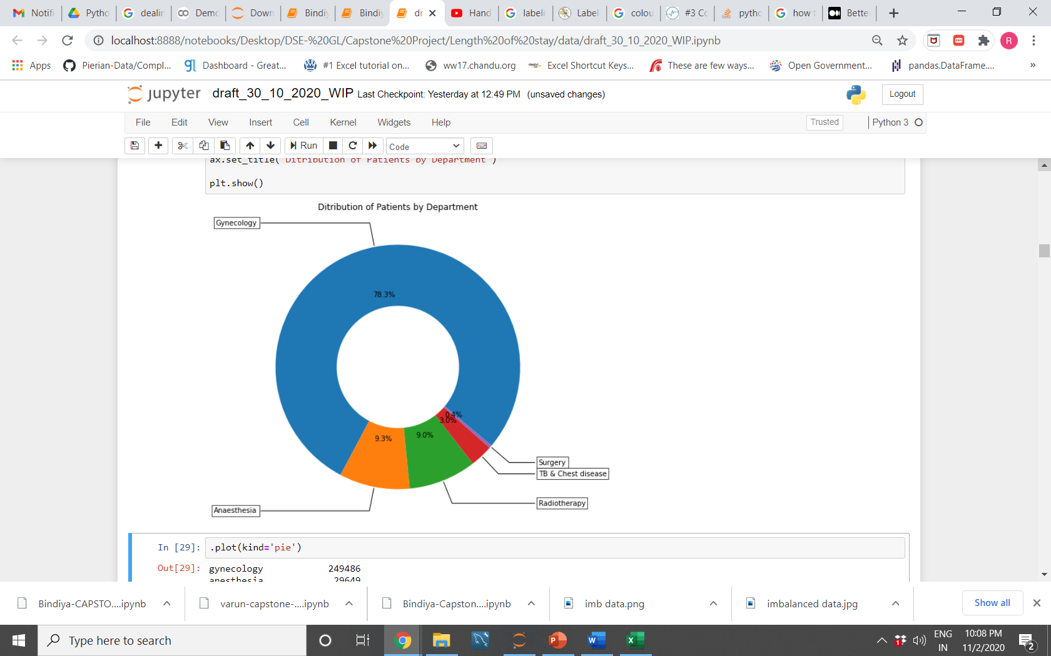
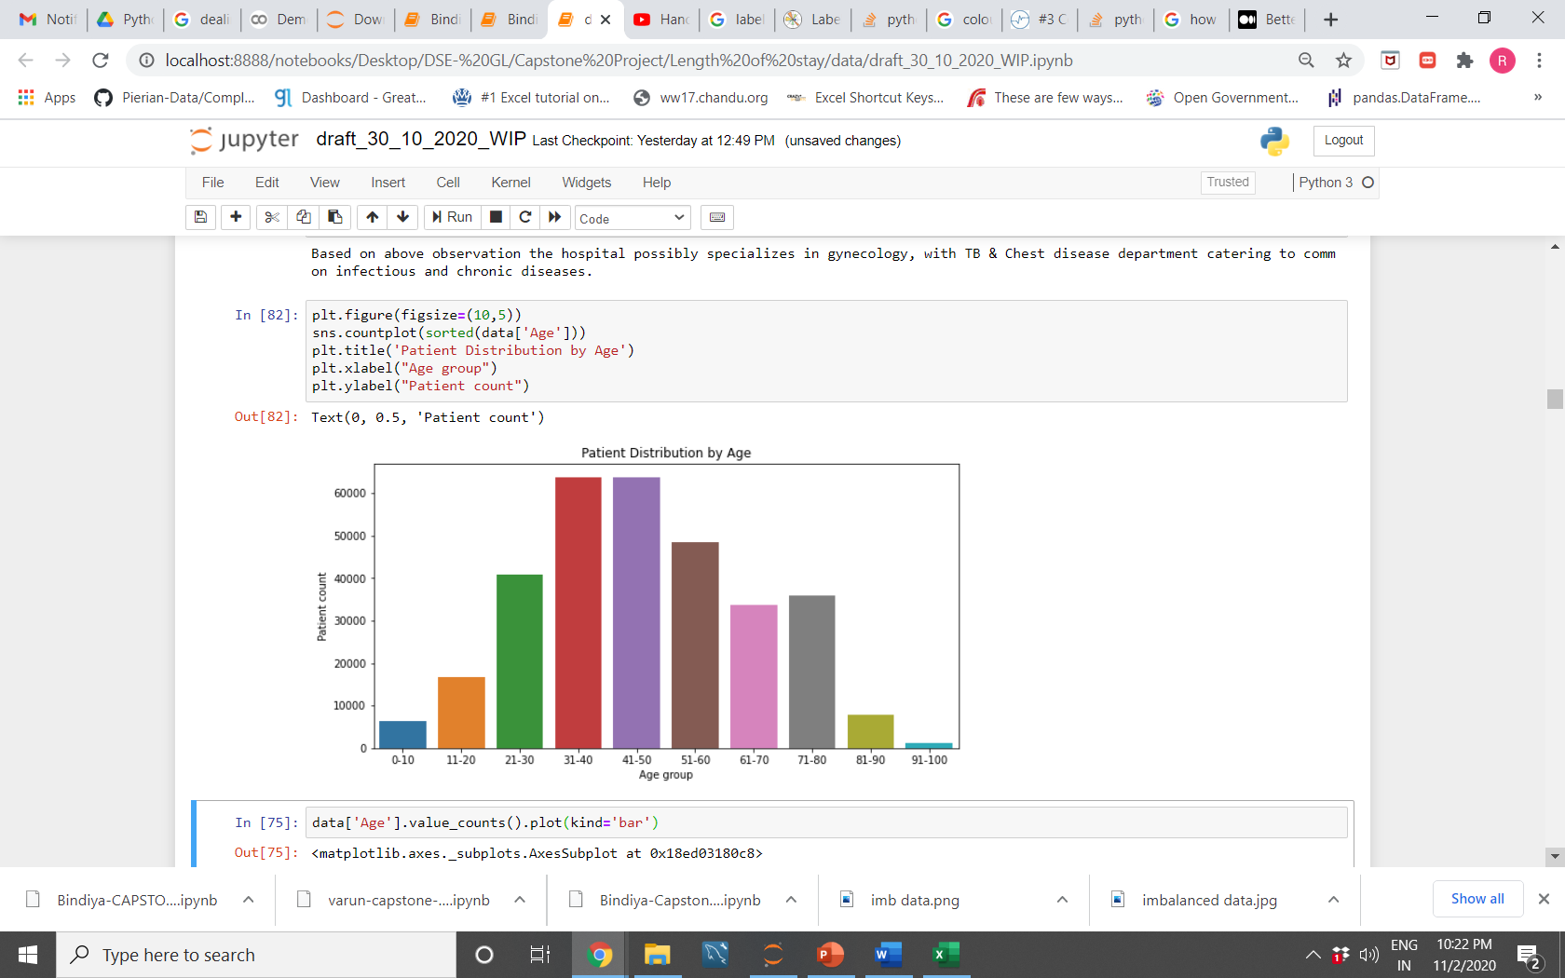
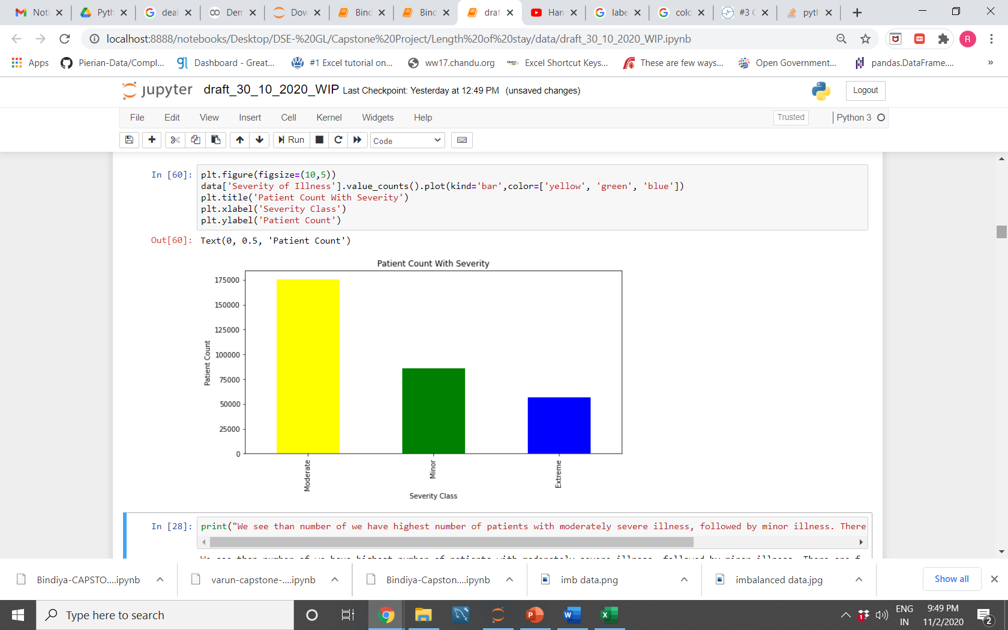
Univariate Analysis
Data dominated by Gynecology cases.
Most patients stay in range 11-40 days
Lower counts for extremities of age
Patient distribution across stay classes
Patient distribution across regions
Patient distribution across department
Patient distribution across age groups
Patient distribution across severity classes
Notes:
Text headings: Not visible

Slide 6
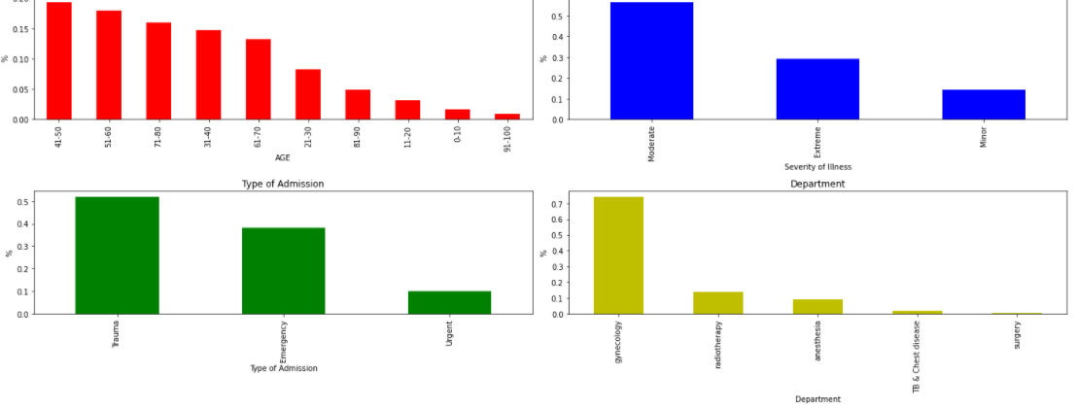
For Los greater than 100 days
Most patients in 41-60 age group
Most patients moderately severe followed by extreme
Most trauma cases followed by emergency
Patient distribution by age
Patient distribution by severity of illness
Patient distribution by admission type
Patient distribution by department
Notes:
Separate.. Text heading

Slide 7
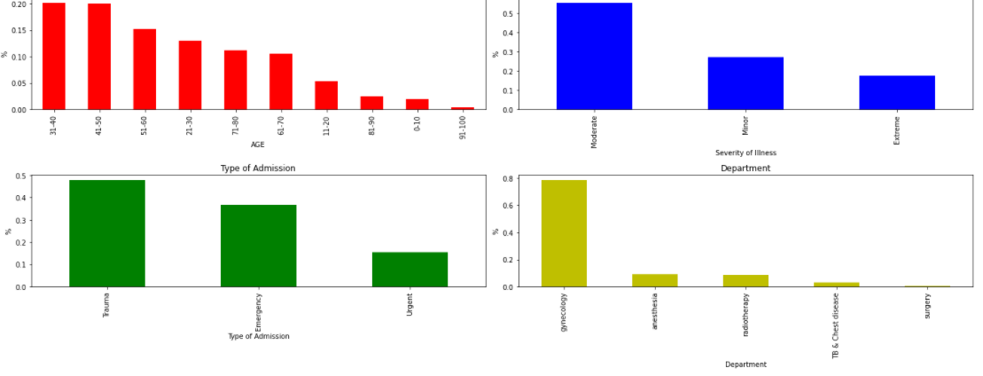
For Los Less than 100 days
Most patients in 31-50 age group
Most patients moderately severe followed by minor
Most trauma cases followed by emergency
Patient distribution by age
Patient distribution by severity of illness
Patient distribution by admission type
Patient distribution by department
Notes:
Separate.. Text heading

Slide 8
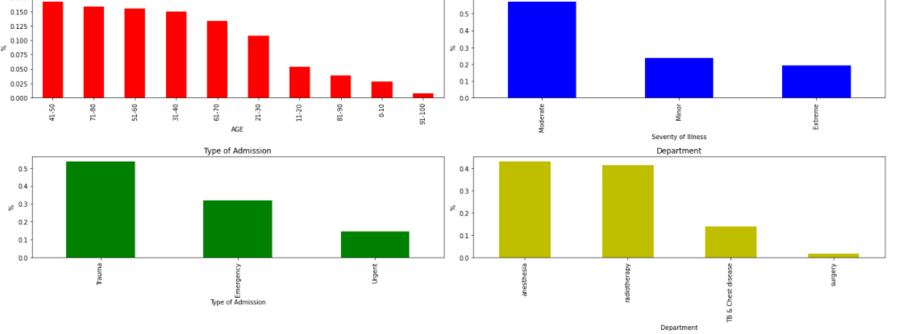
DATA without Gynecology cases
Most patients in 41-50 age group
Most patients moderately severe followed by minor
Most trauma cases followed by emergency
Most cases referred to Anesthesia and Radiology departments
Patient distribution by age
Patient distribution by severity of illness
Patient distribution by admission type
Patient distribution by department

Slide 9
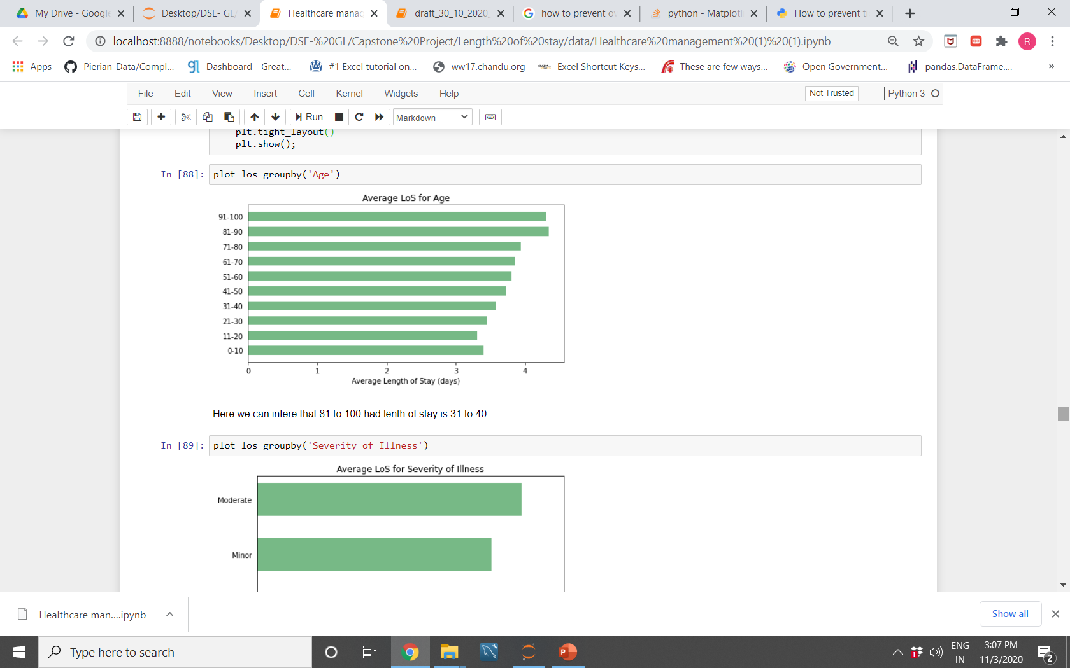
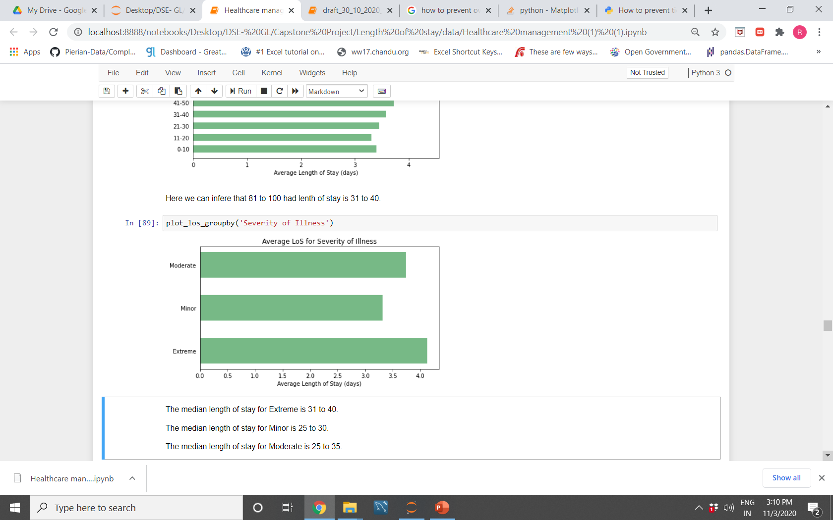
LoS has been encoded into numerical values.
Notes:
Bullets..

Slide 10
Statistical analysis
Chi- Squared test to check if a feature is uniform across stay categories.
ANOVA to check if a multiclass feature varies across stay categoris.
Results
Chi Squared test:
All features significantly varied across stay categories
Anova test:
Done for ‘Severity of illness’ with stay categories
All three severity classes significantly varied across stay categories
Notes:
Remove code

Slide 11
Feature engineering
No obvious correlation
Logical route for feature engineering
 | Method | Rationale
Removing features | Feature Dropped | Unique for all entries No expected/observed effect on patient stay
Encoding | One hot encoding | Nominal Variable
5 | Manual weight assignment | Ordinal Variable

Slide 12
Scenarios for model building
Distribution of data as per specified scenario
Scenario 1:Classification based on 4 classes in Stay column
Scenario 2:Classification based on 3 classes in Stay column
Class | Stay Duration
1 | 0-30 days
2 | 31-60 days
3 | 61-80 days
4 | More than 80 days
Class | Stay Duration
1 | 0-40 days
2 | 41-70 days
3 | More than 70 days
Notes:
Explain scene in text

Slide 13
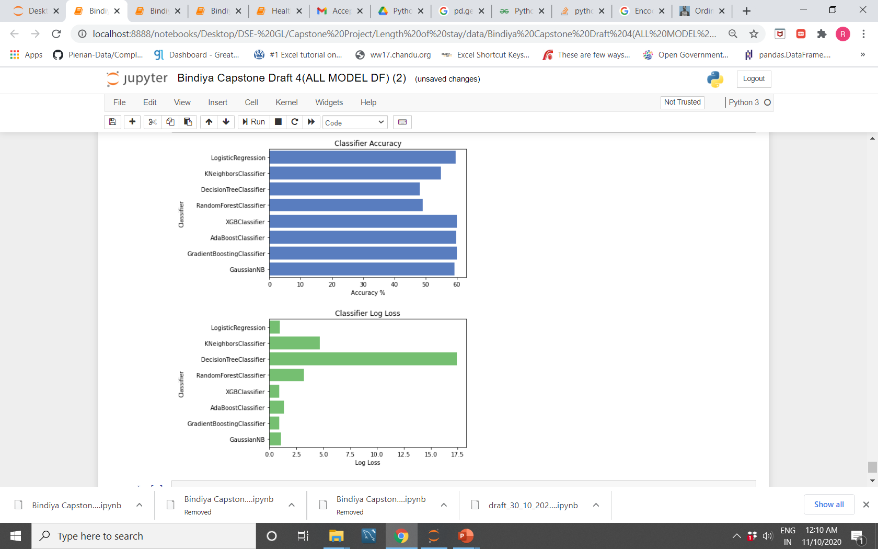
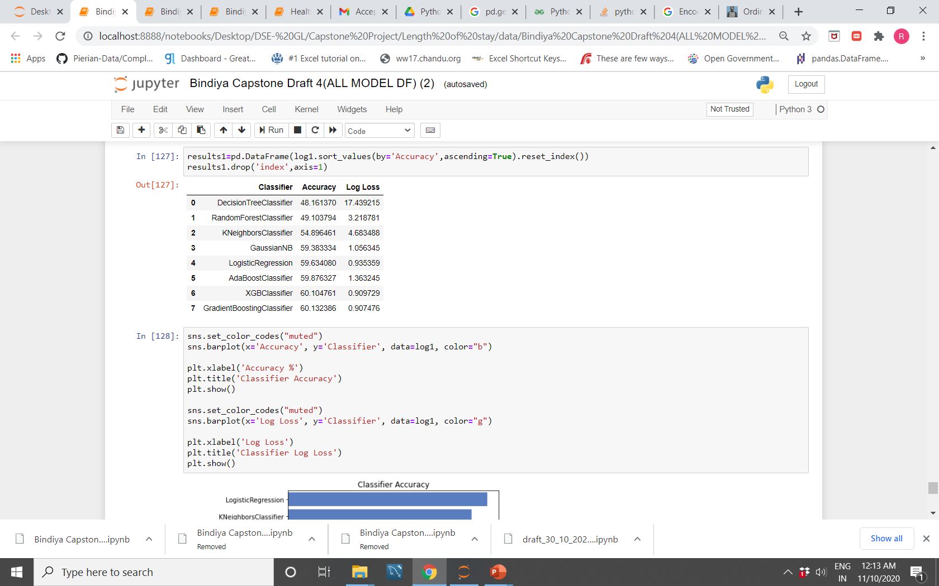
Model performance: scenario 1
Classification based on 4 classes in Stay column

Slide 14
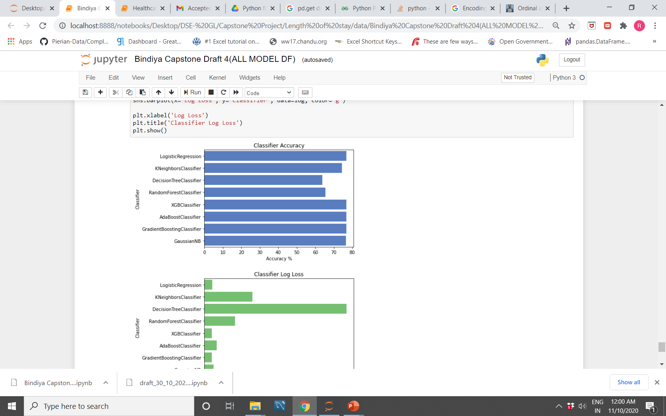
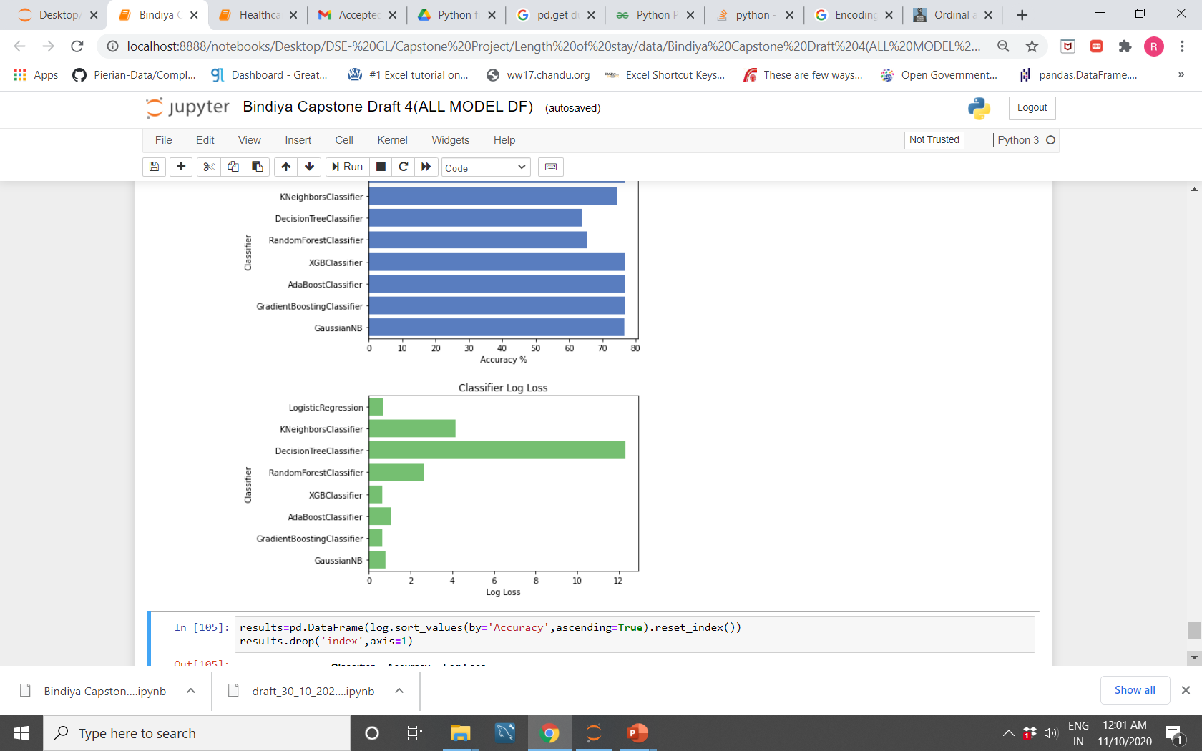
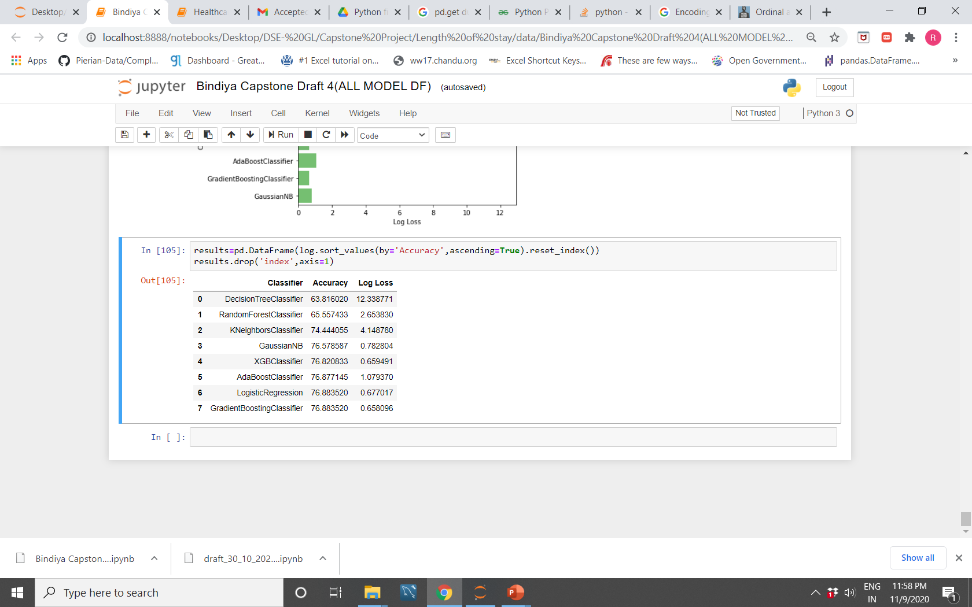
Model performance: scenario 2
Classification based on 3 classes in Stay column

Slide 15
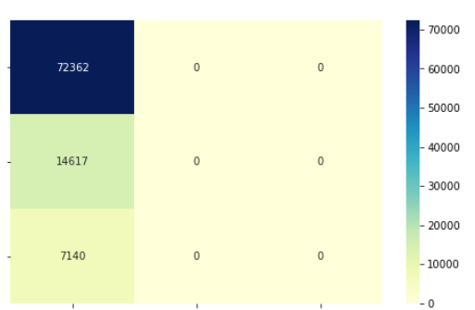
Performance metrics for best performing model
Scenario 2- Gradient Boosting Classifier. Model fails to classify properly. We tweak the approach.
1
Confusion Matrix
2
Actual
3
1
2
3
Predicted

Slide 16
Updated Scenarios for model building
Distribution of data as per updated scenario
Scenario 1:Classification based on 4 classes in Stay column
Scenario 2:Classification based on 3 classes in Stay column
Class | Stay Duration
1 | 0-30 days
2 | 31-60 days
3 | 61-80 days
4 | More than 80 days
Class | Stay Duration
1 | 0-30 days
2 | 31-70 days
3 | More than 70 days

Slide 17
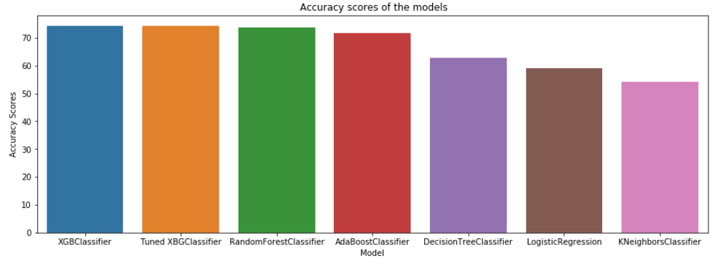
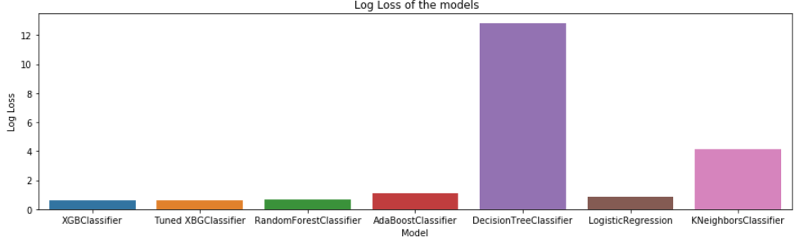
Model performance for updated input
Scenario 2: XGBoost Classifer with hyperparameter tuning gives best performance
Accuracy Scores
Total Loss

Slide 18
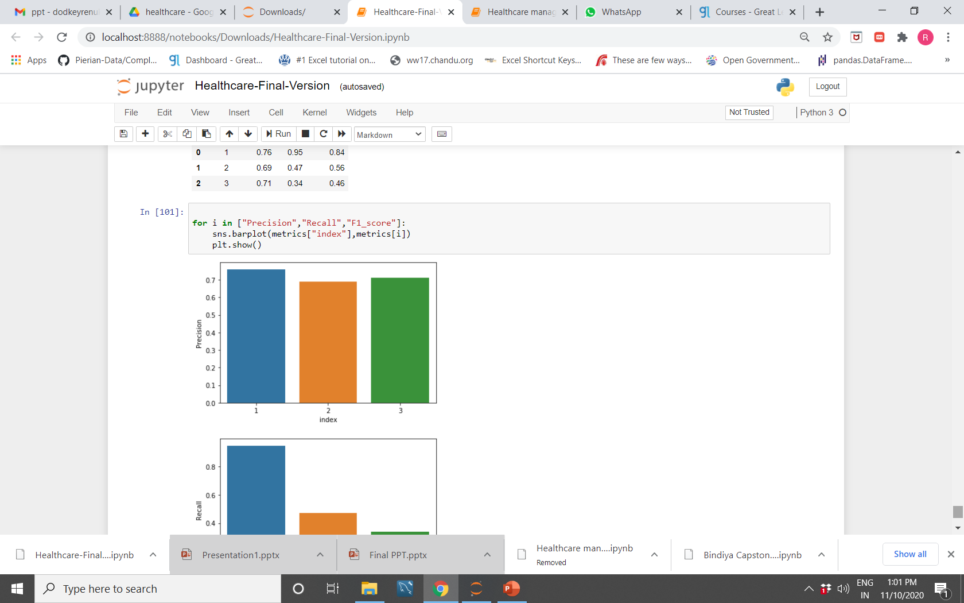
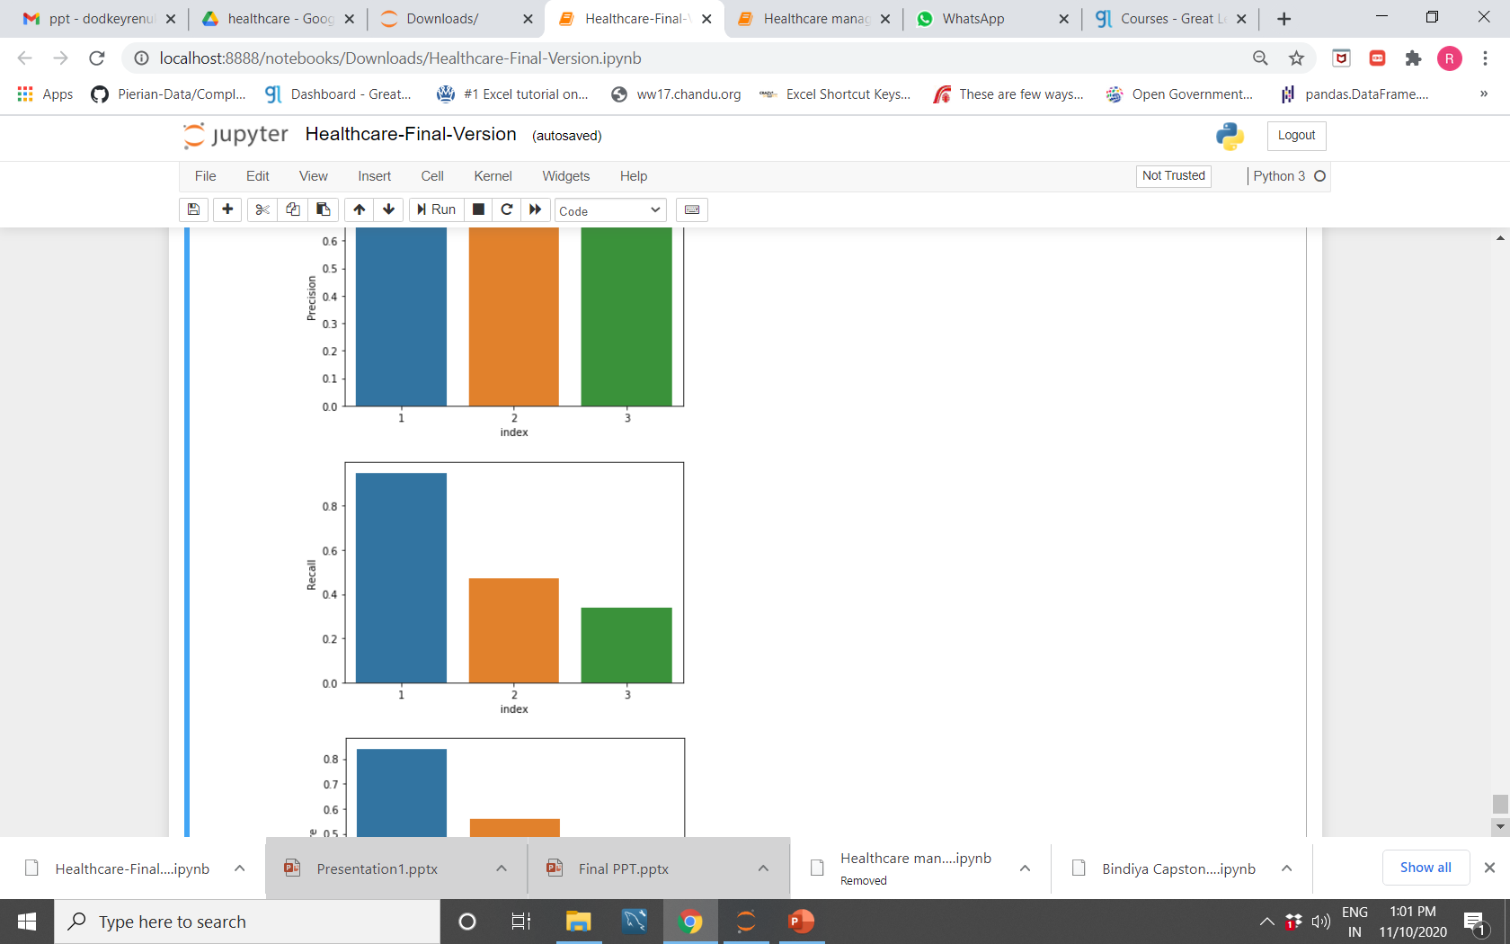
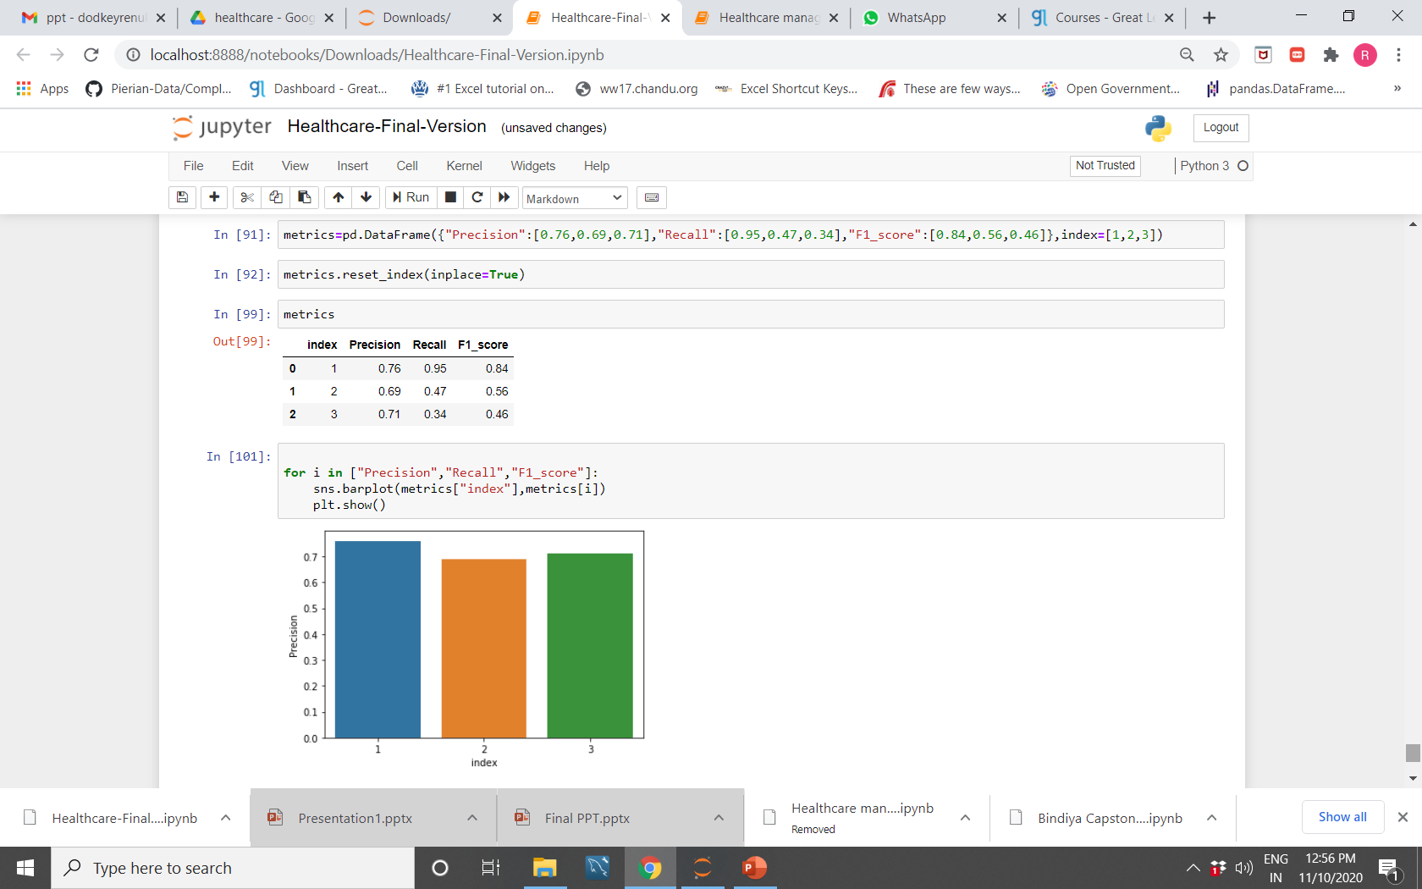
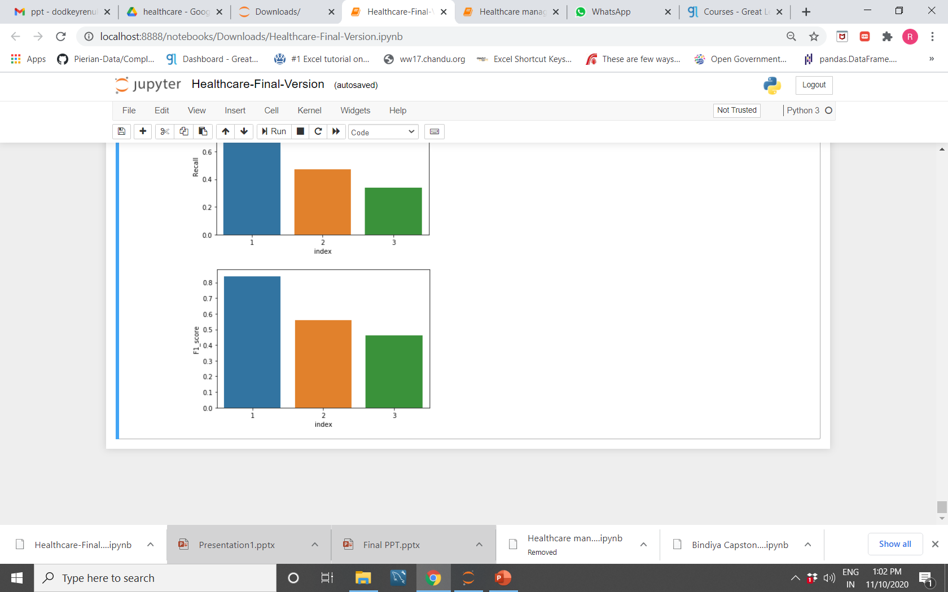
Performance metrics for best performing model
Scenario 2- Gradient Boosting Classifier. Model classification better with chosen approach
Performance Metrices
Metrics score
Class
Class
Class
Class

Slide 19
Business Inference
Target column redistributed into 3 groups give a better performing model.
Model can help predict the stay range of patients as short duration: 0-30 days, medium duration: 31-70 days and long duration: more than 70 days
Best model: XGBoost Classifier( Accuracy: 74.321%, Loss: 0.6126)
Hospitals can use this information for operational planning
Useful for resource planning and distribution
Efficiency of planning expected to reduce costs
Steps in an attempt to reduce actual LoS in comparison to predicted
Timely diversion of surplus patient load ensuring minimal time lapse in decision making

Slide 20
Thank you!

Slide 21


